Slide 1
Gradient Descent
Dr. Md. Golam Rabiul Alam

Slide 2
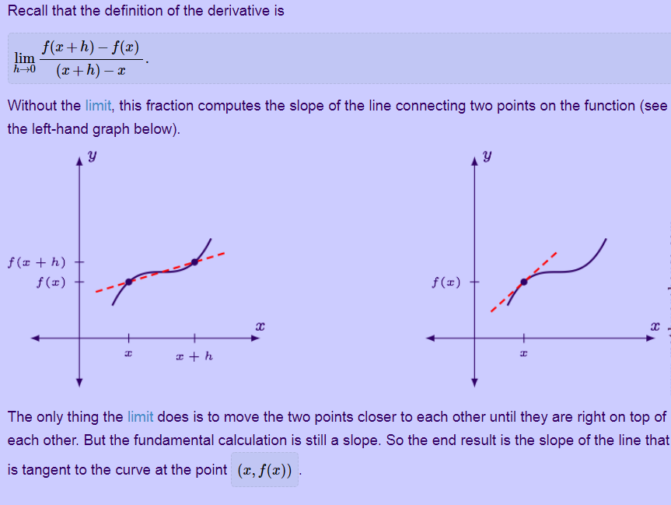
Derivative

Slide 3
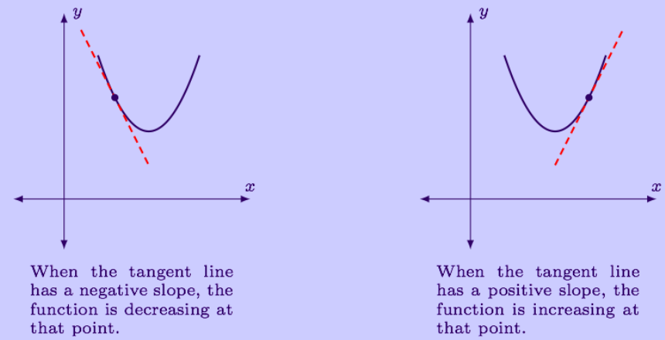
Derivative

Slide 4
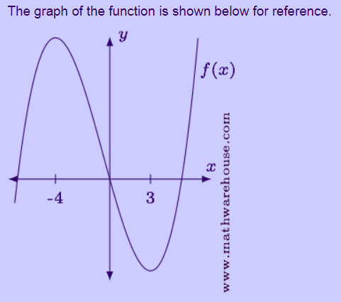
Derivative

Slide 5
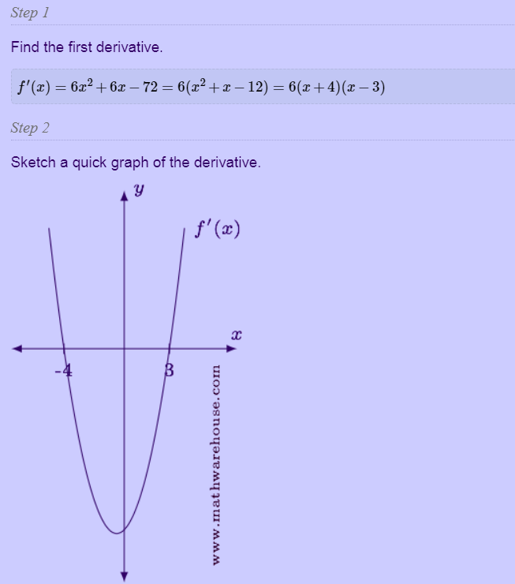
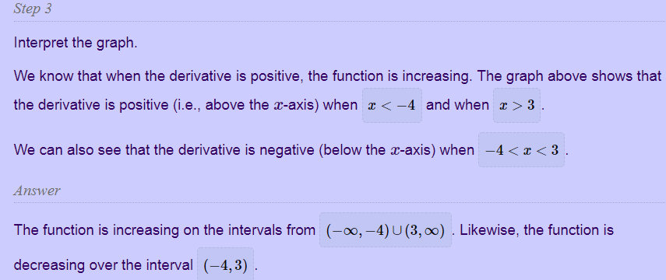
Derivative

Slide 6
Gradient Descent
Two or more derivatives of the same function are called Gradients.
An algorithm which uses gradient to descent to the lowest point of a loss function.

Slide 7
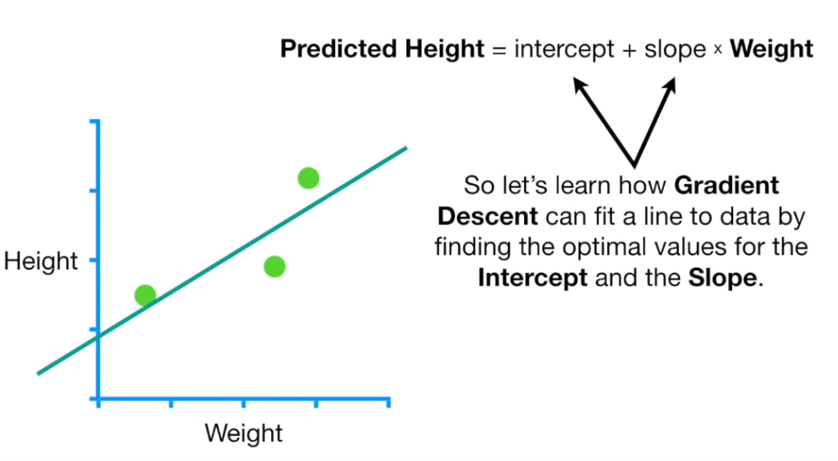
Gradient Descent

Slide 8
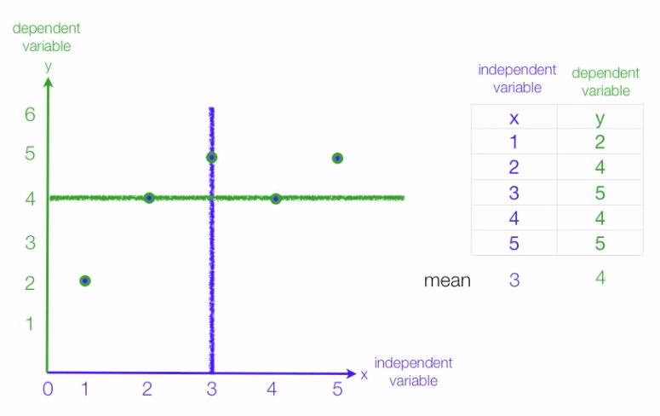
Least Square Method

Slide 9
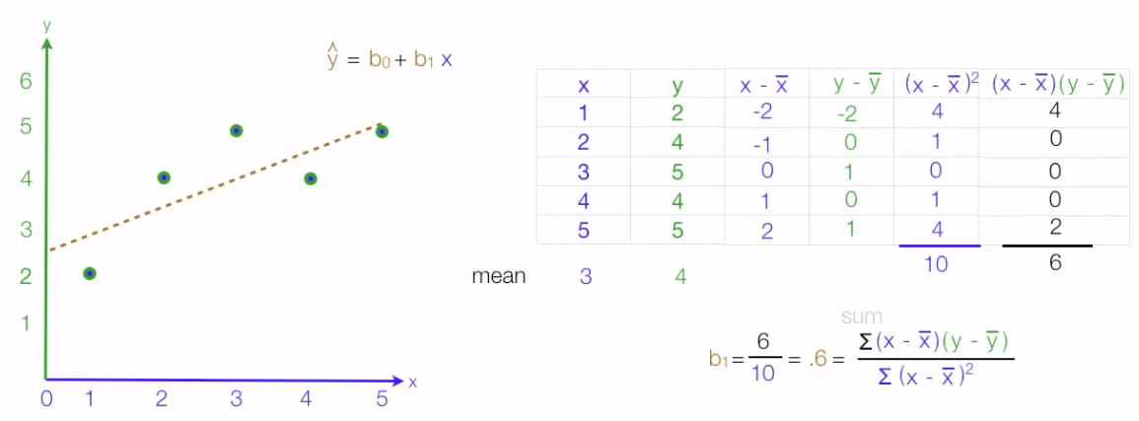
Least Square Method

Slide 10
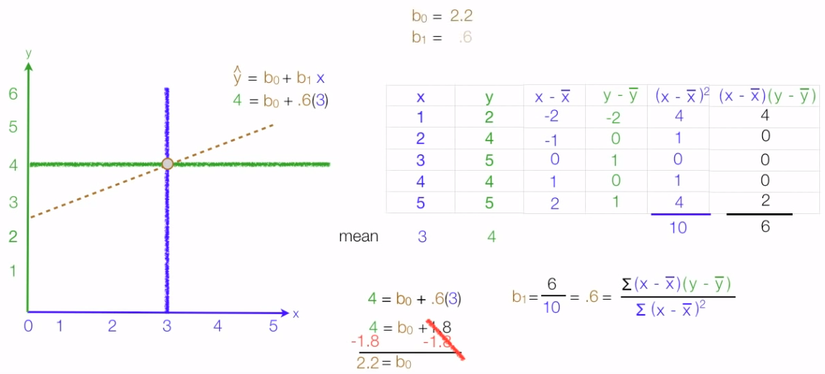
Least Square Method

Slide 11
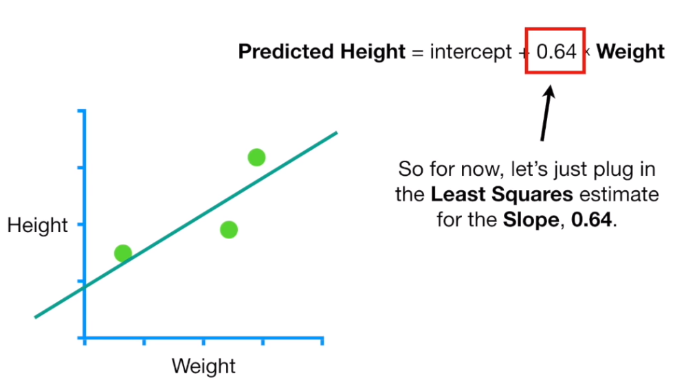
Gradient Descent

Slide 12
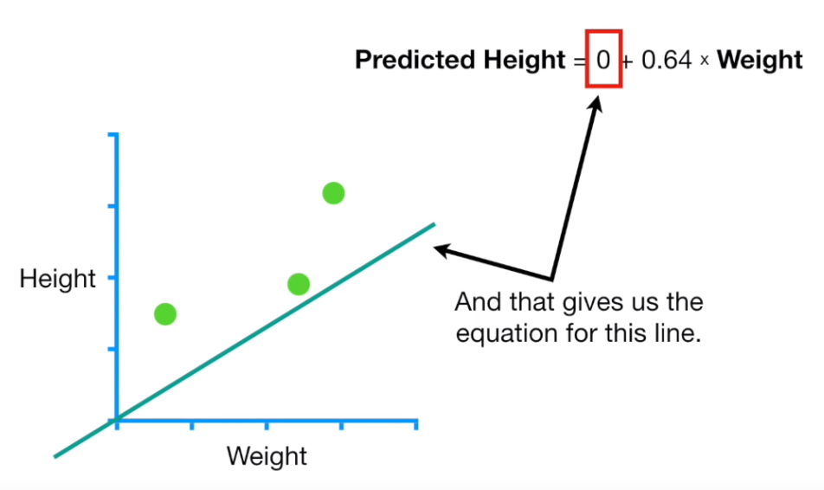
Gradient Descent

Slide 13
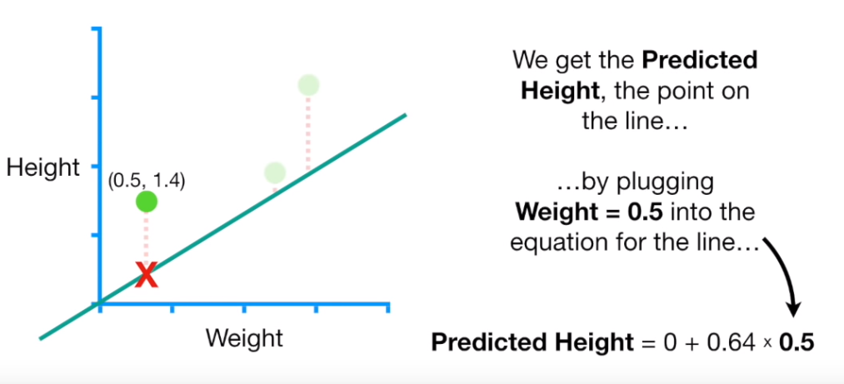
Gradient Descent

Slide 14
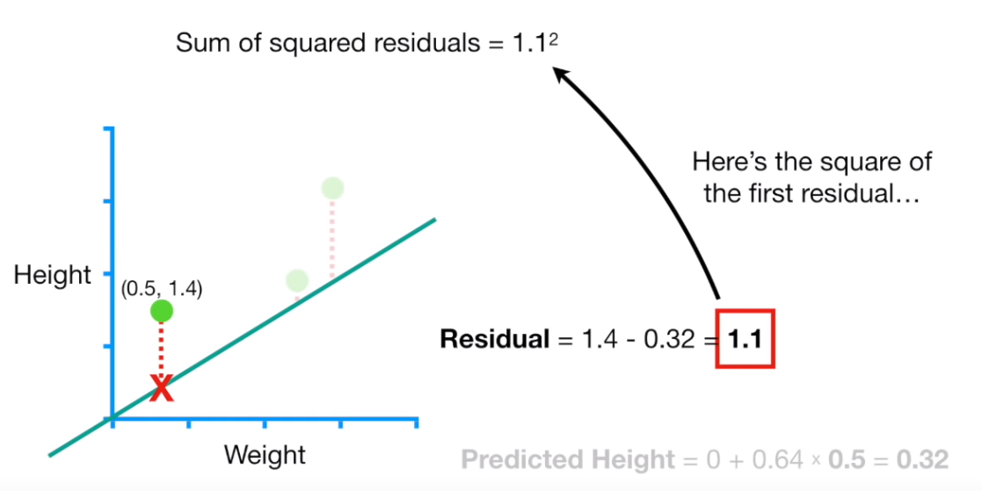
Gradient Descent

Slide 15
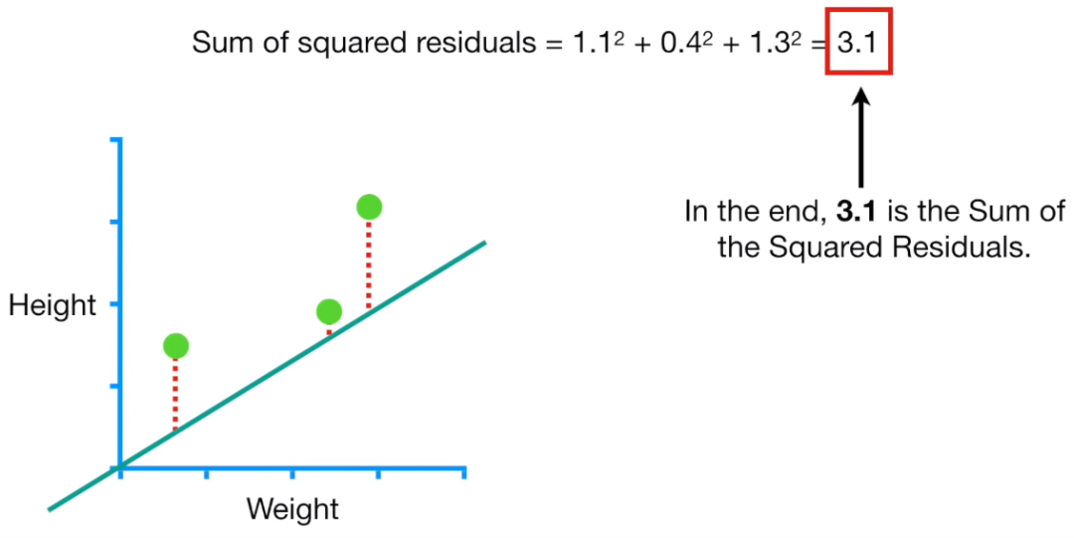
Gradient Descent

Slide 16
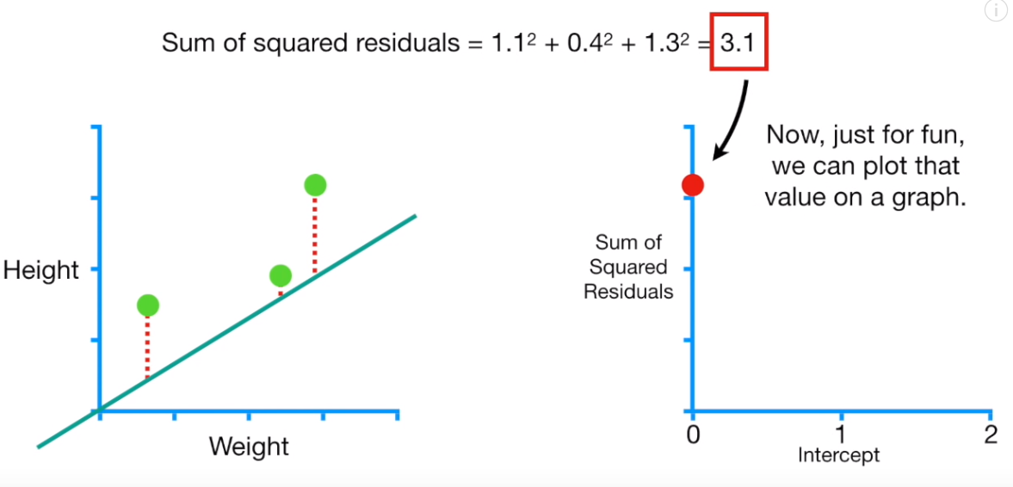
Gradient Descent

Slide 17
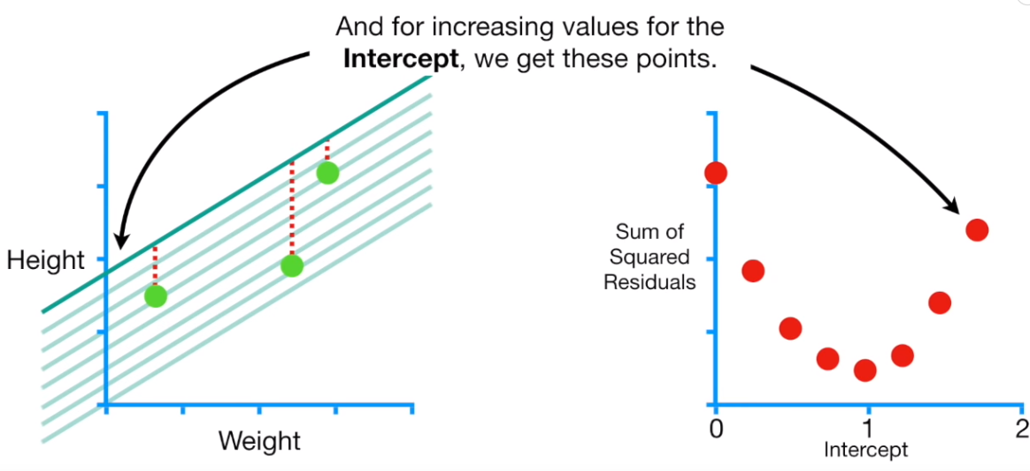
Gradient Descent

Slide 18
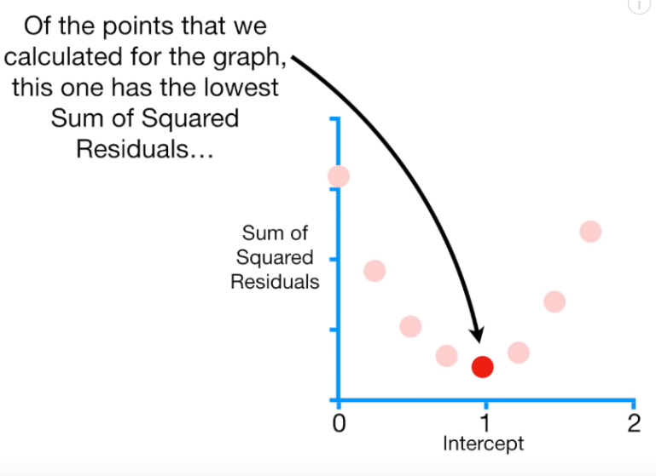
Gradient Descent

Slide 19
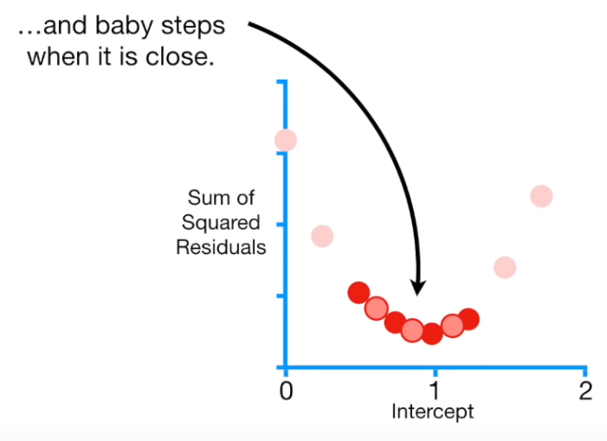
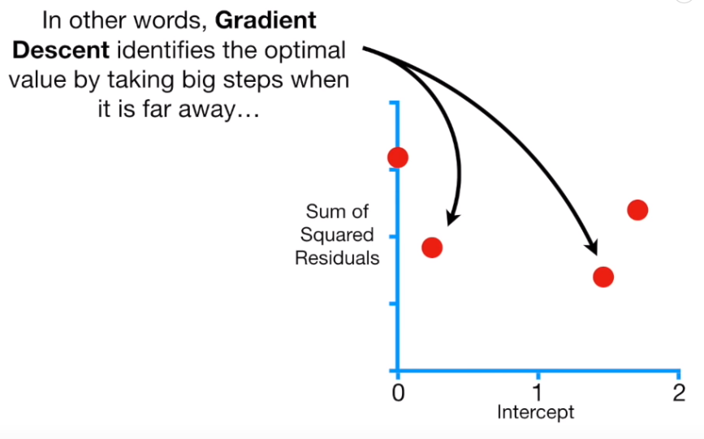
Gradient Descent

Slide 20
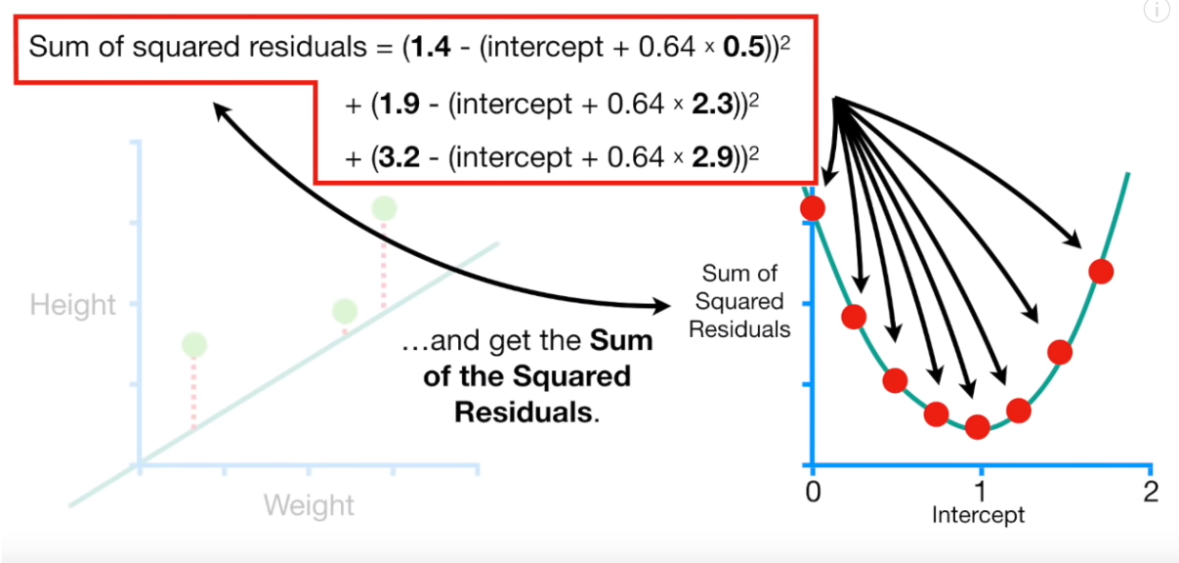
Gradient Descent

Slide 21
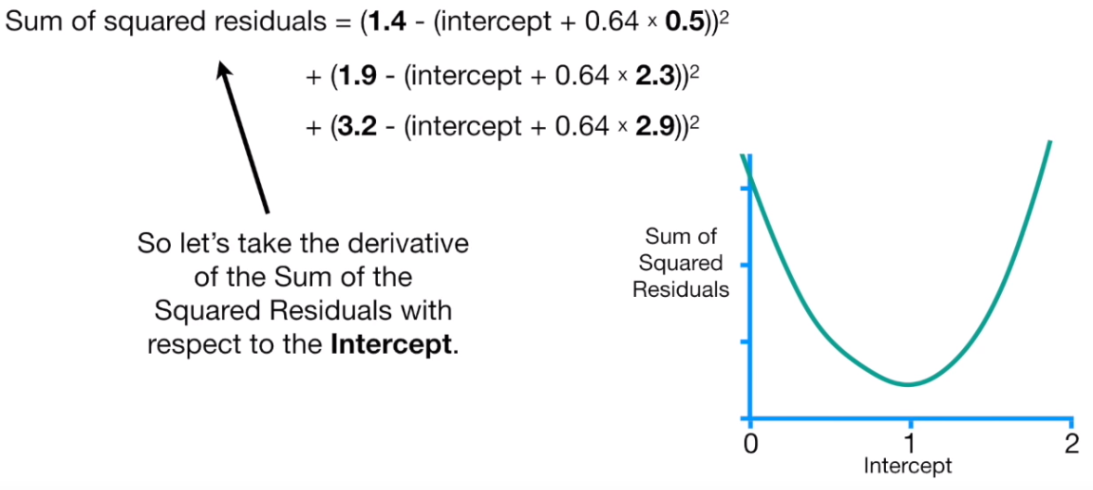
Gradient Descent

Slide 22
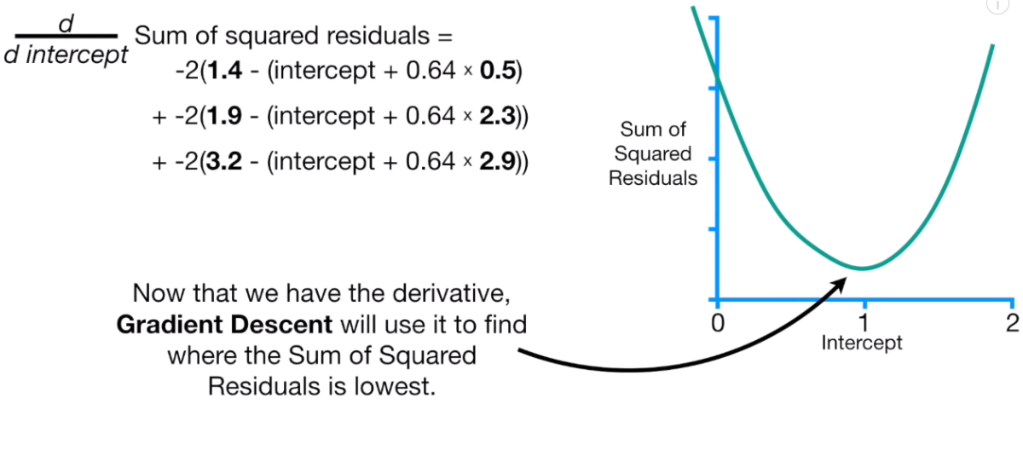
Gradient Descent

Slide 23
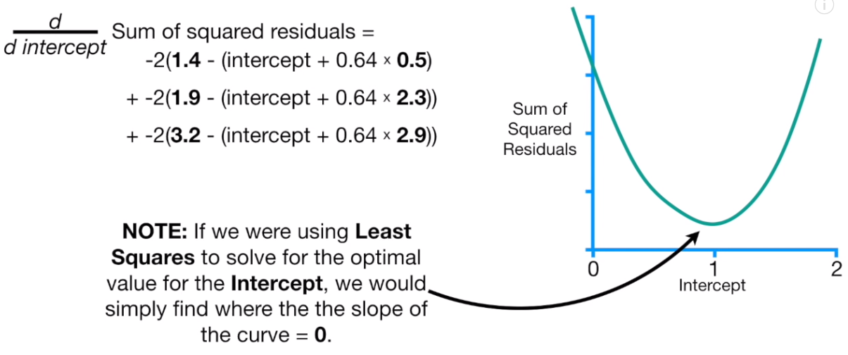
Gradient Descent

Slide 24
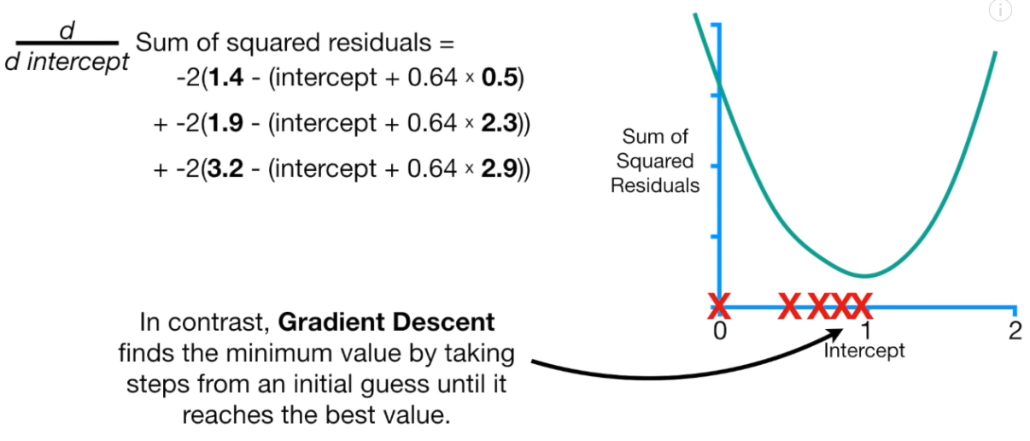
Gradient Descent

Slide 25
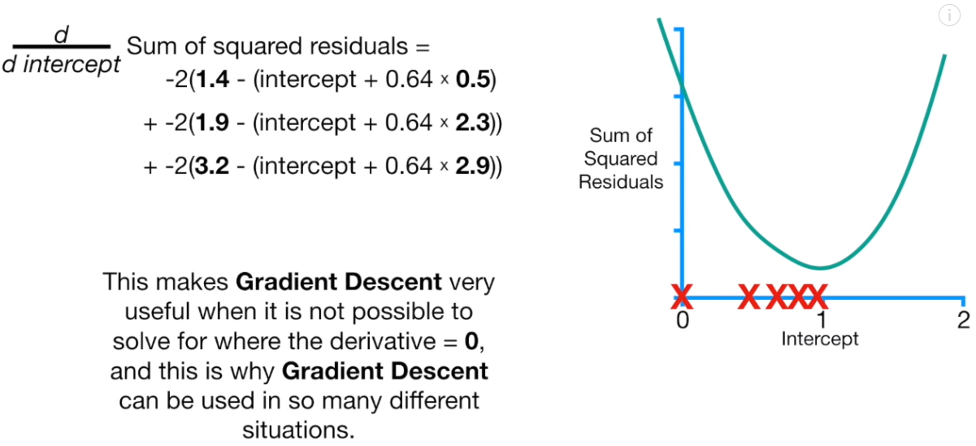
Gradient Descent

Slide 26
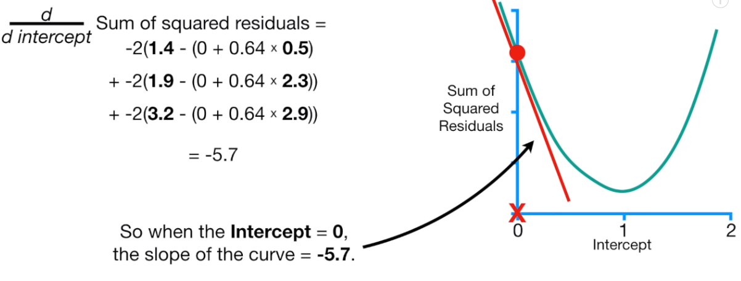
Gradient Descent

Slide 27
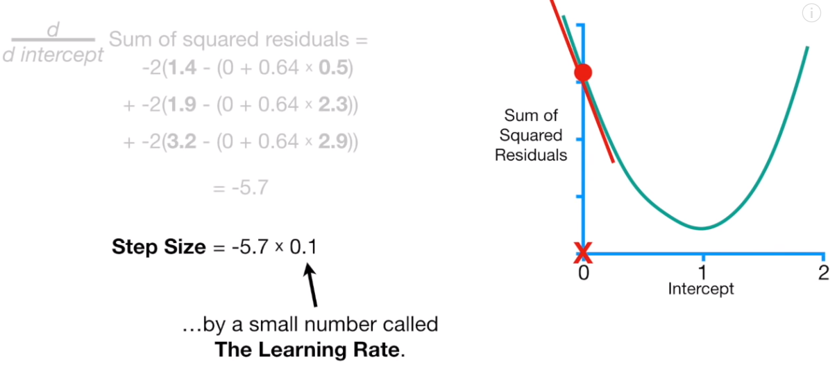
Gradient Descent

Slide 28
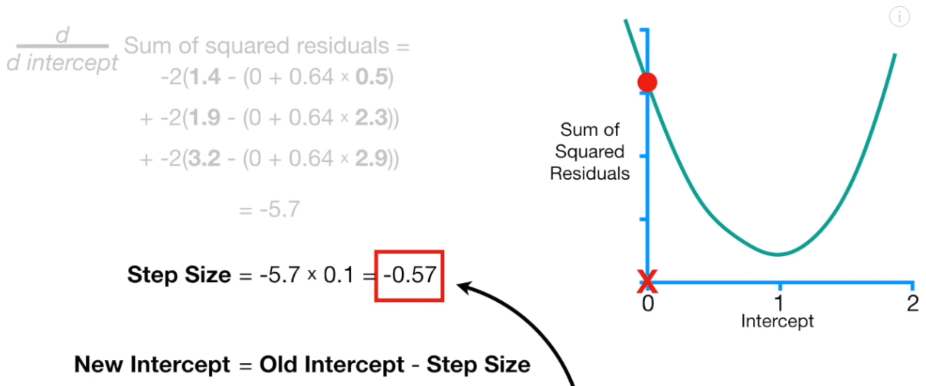
Gradient Descent

Slide 29
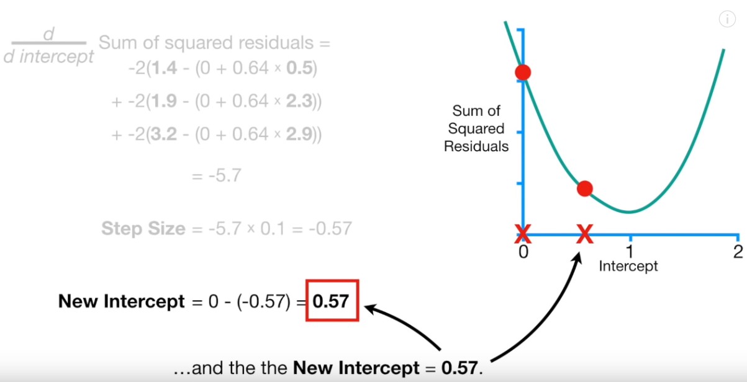
Gradient Descent

Slide 30
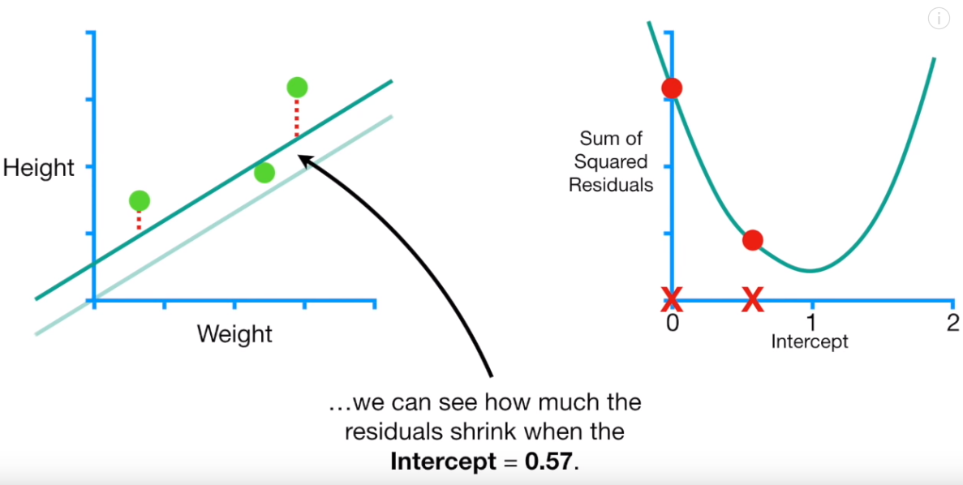
Gradient Descent

Slide 31
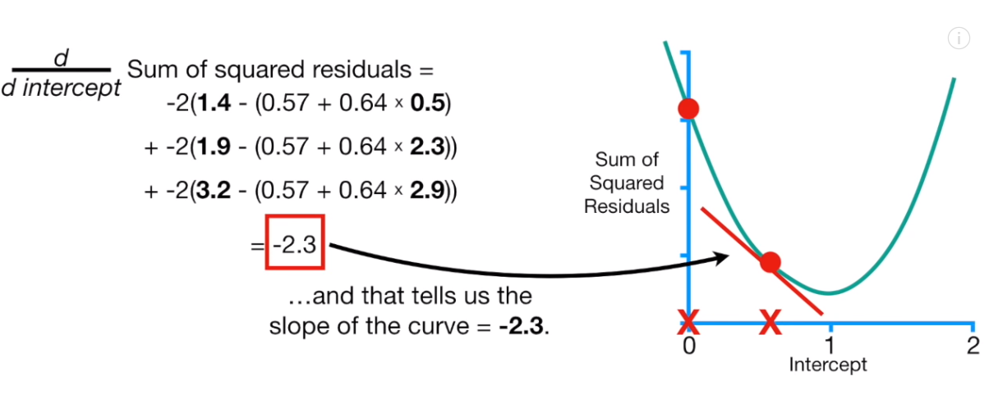
Gradient Descent

Slide 32
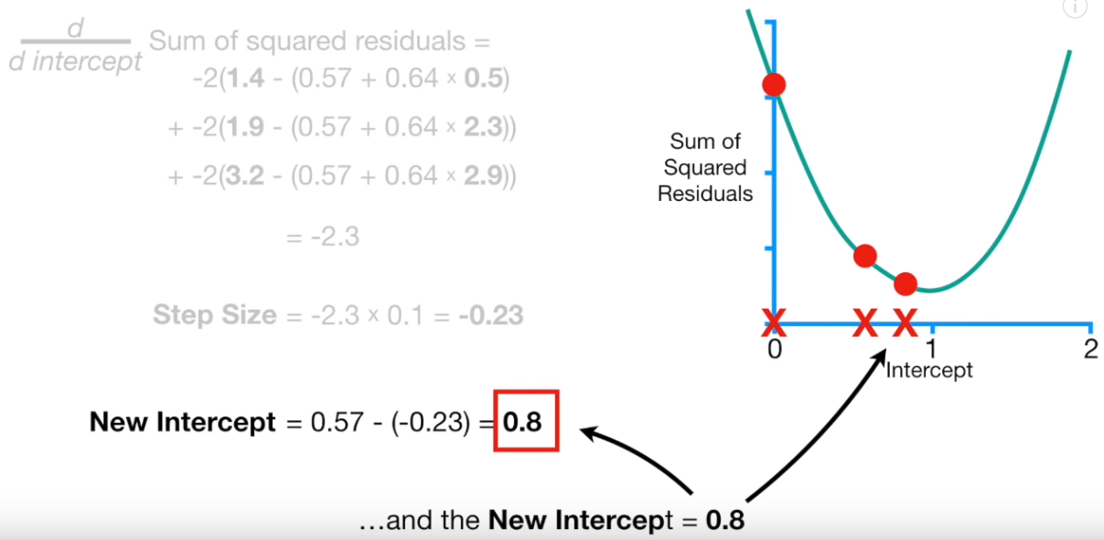
Gradient Descent

Slide 33
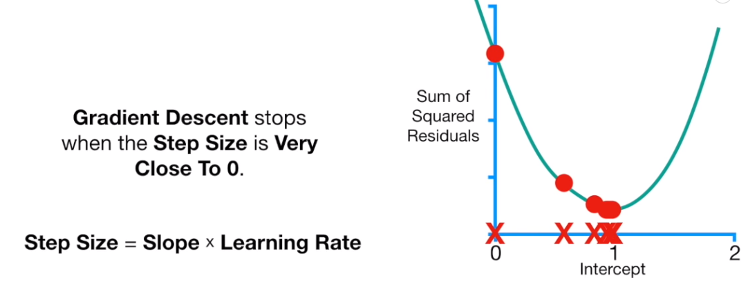
Gradient Descent

Slide 34
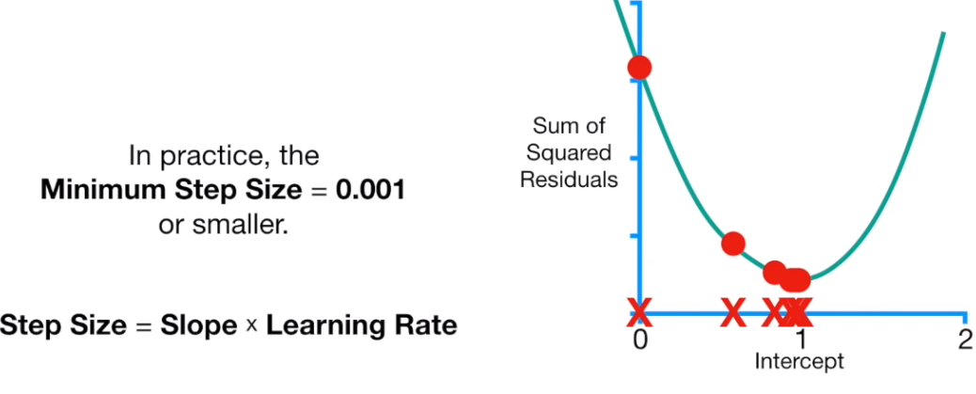
Gradient Descent

Slide 35
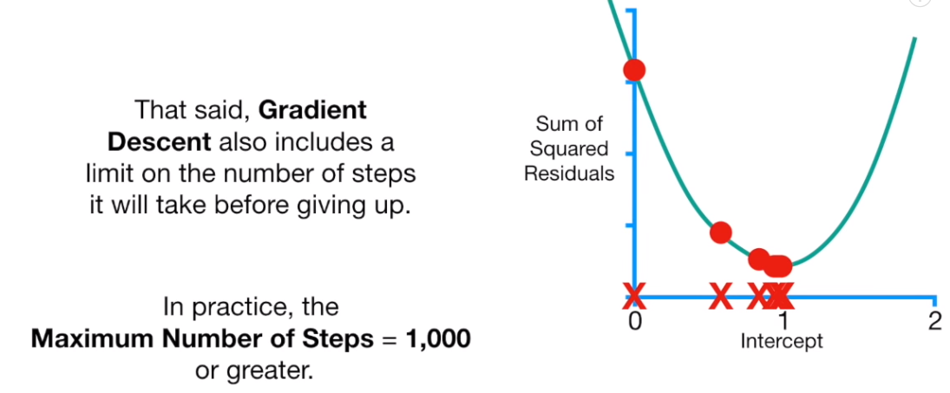
Gradient Descent

Slide 36
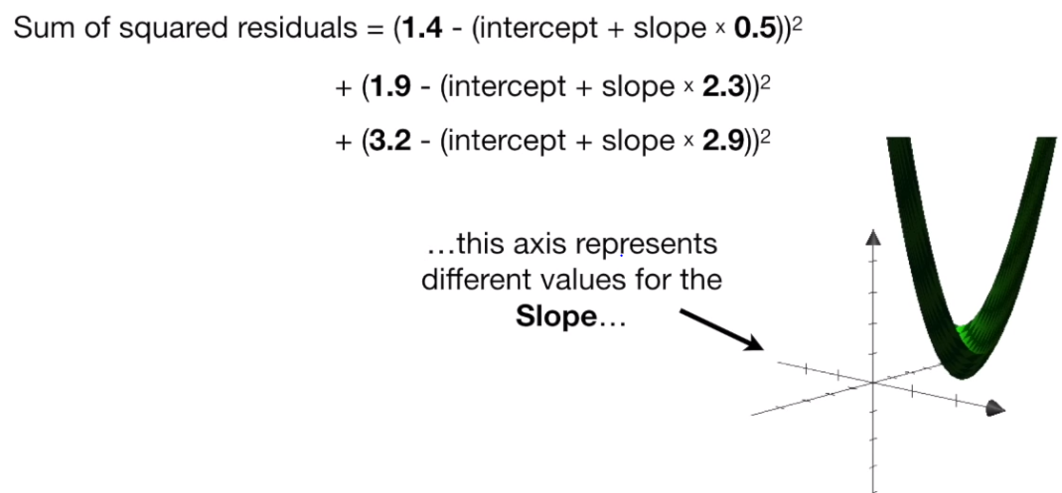
Gradient Descent

Slide 37
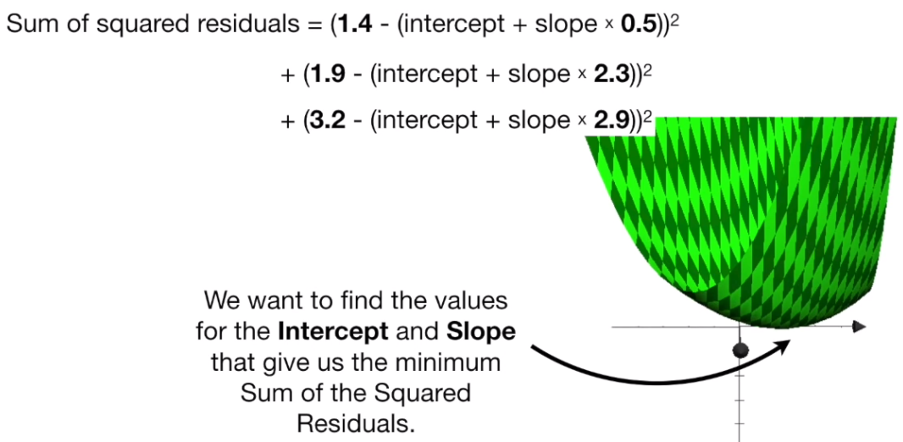
Gradient Descent

Slide 38
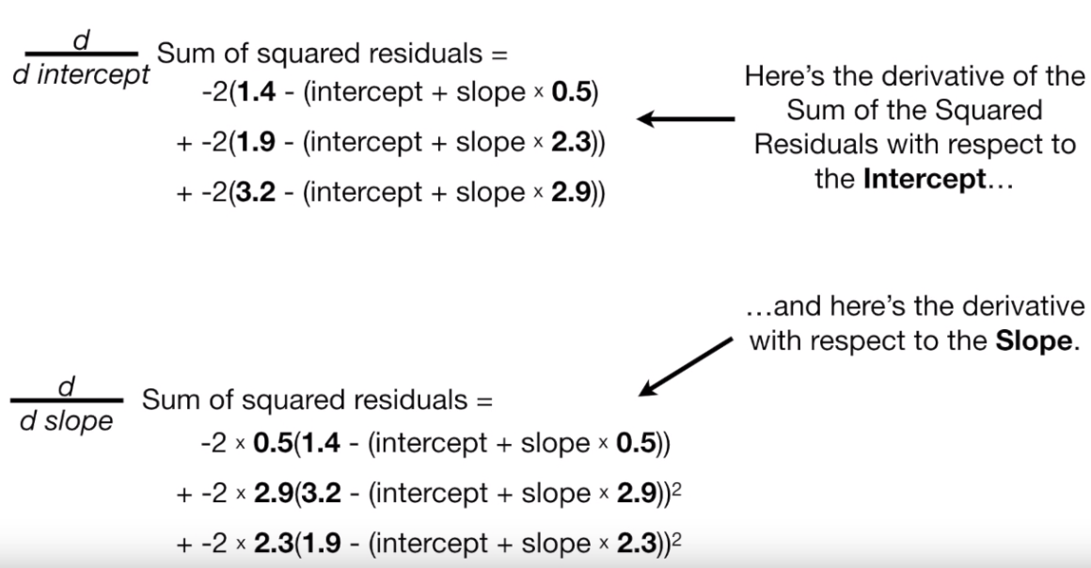
Gradient Descent

Slide 39
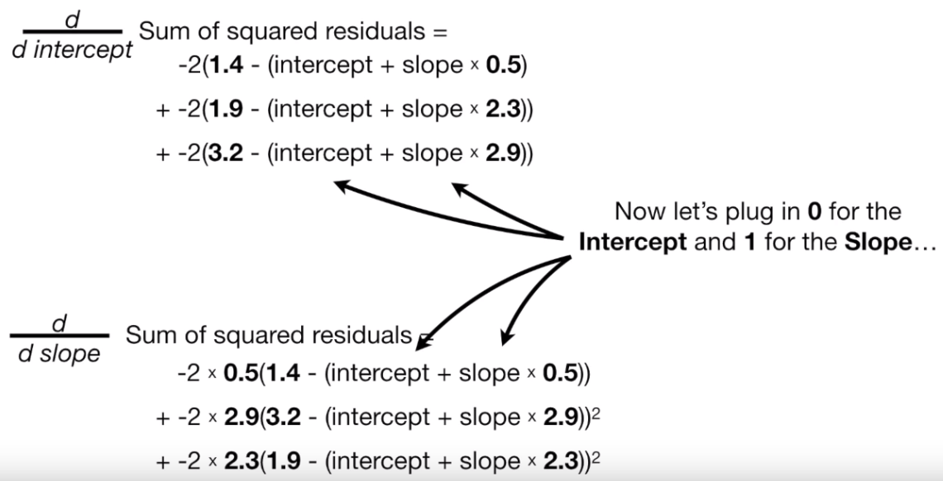
Gradient Descent

Slide 40
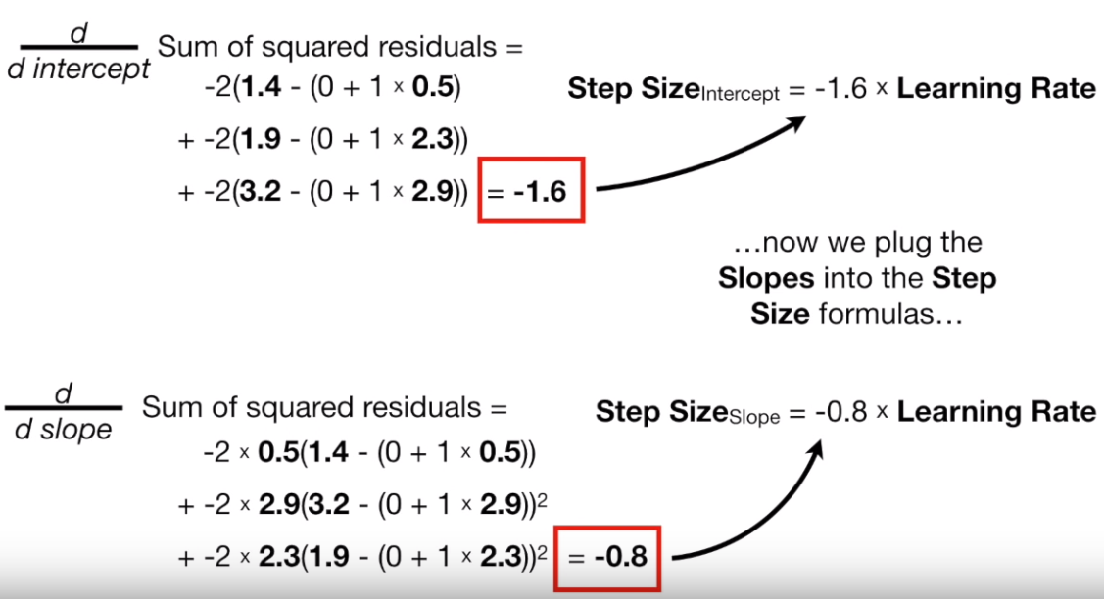
Gradient Descent

Slide 41
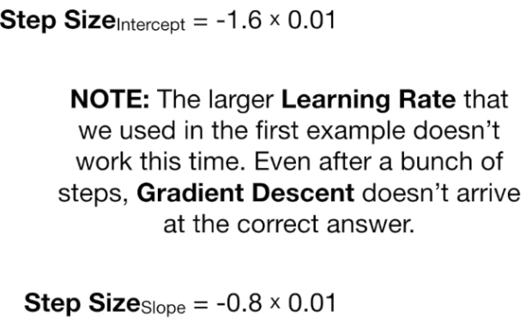
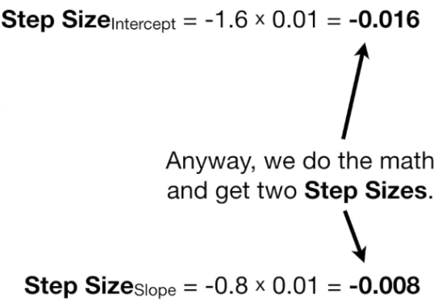
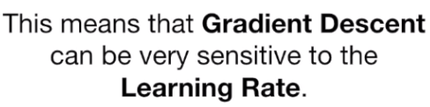
Gradient Descent

Slide 42
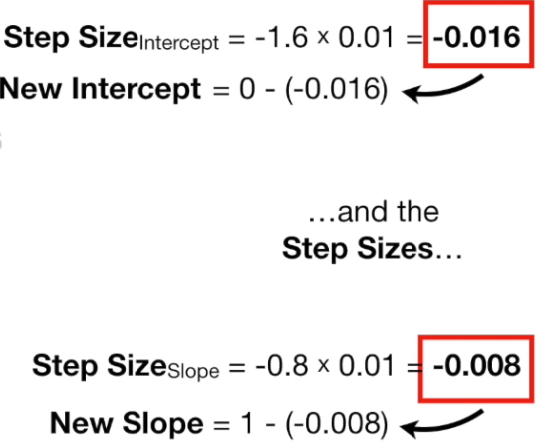
Gradient Descent

Slide 43
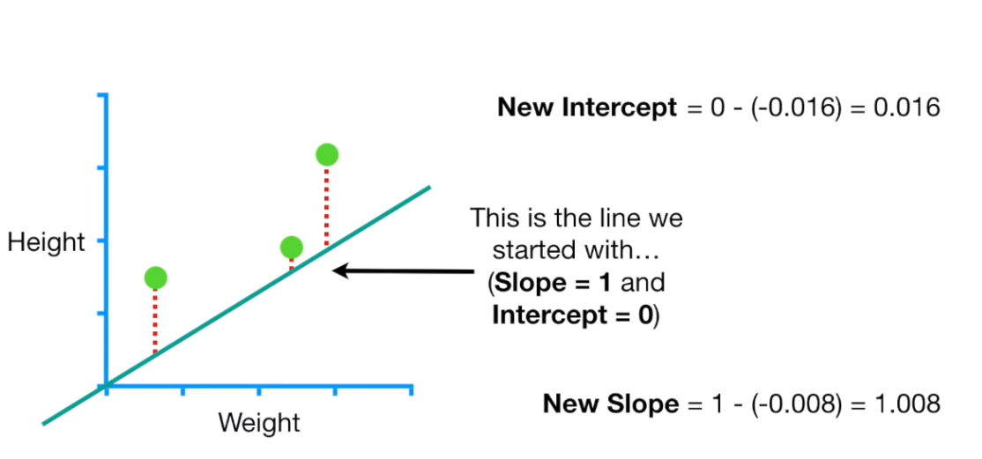
Gradient Descent

Slide 44
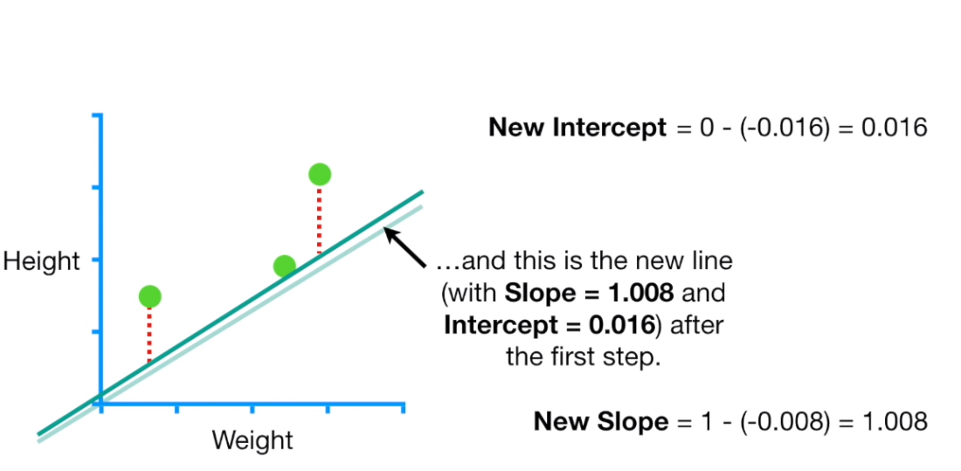
Gradient Descent

Slide 45
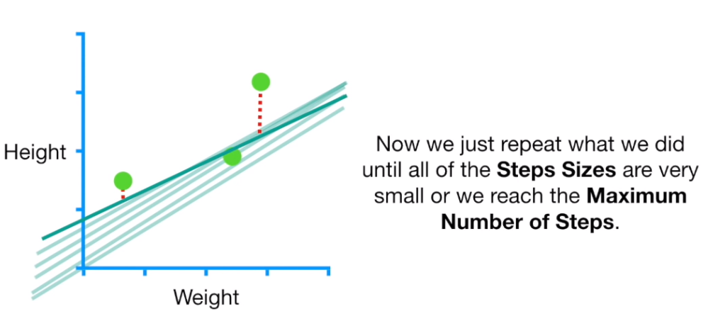
Gradient Descent

Slide 46
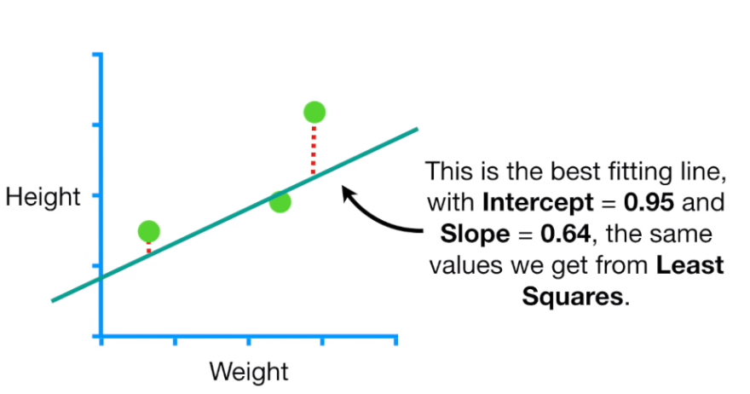
Gradient Descent

Slide 47
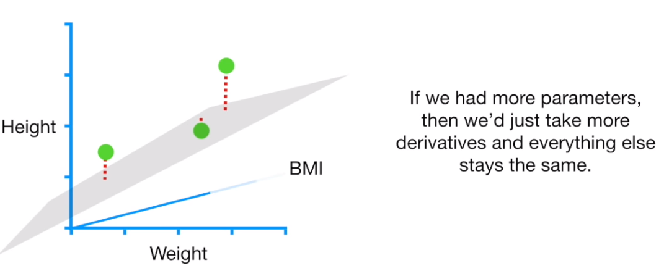
Gradient Descent

Slide 48
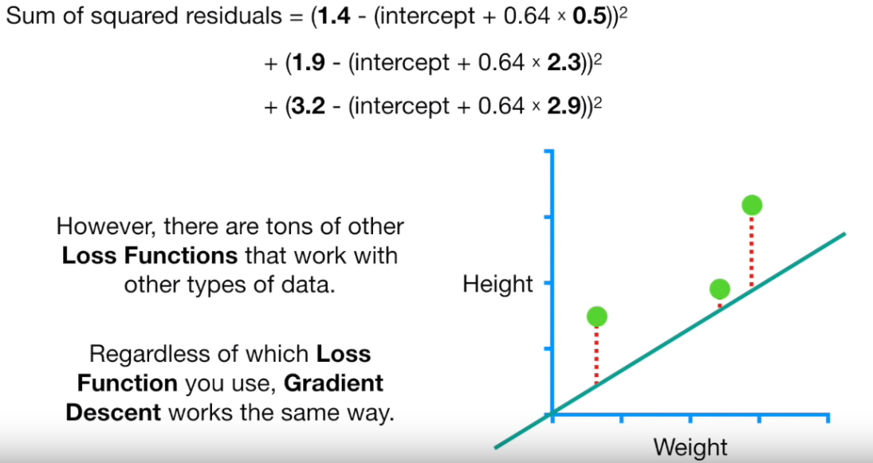
Gradient Descent

Slide 49





Gradient Descent

Slide 50

Steps in Gradient Descent

Slide 51

Gradient Descent

Slide 52

Gradient Descent

Slide 53

Stochastic Gradient Descent (SGD)

